Slide 1
Class 6: Simple Logistic Regression (II) and Multiple Logistic Regression

Slide 2
Announcements
Homework 1 – grades back this evening
Thanks to Trisha and Bryon!
For Question 5, ambiguous about what I want to see in criteria – please include sample size criteria (if any) for using the test
Question 2 will have more extensive feedback
For all other questions, an X may indicate that a large part of the problem is wrong or that you left out a smaller part like incorrect assumption or hypothesis
It is up to you to figure out what is wrong – ask other students, go to office hours, chat in Slack!
Deadline for Homeworks
Homework is due at 11pm, but there is an hour window to turn it in just in case
If you don’t make this window, you will need to use your “no questions asked” extension
We will revisit interpretation of coefficients again next week in the context of multiple logistic regression

Slide 3
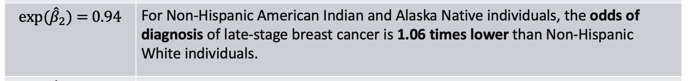
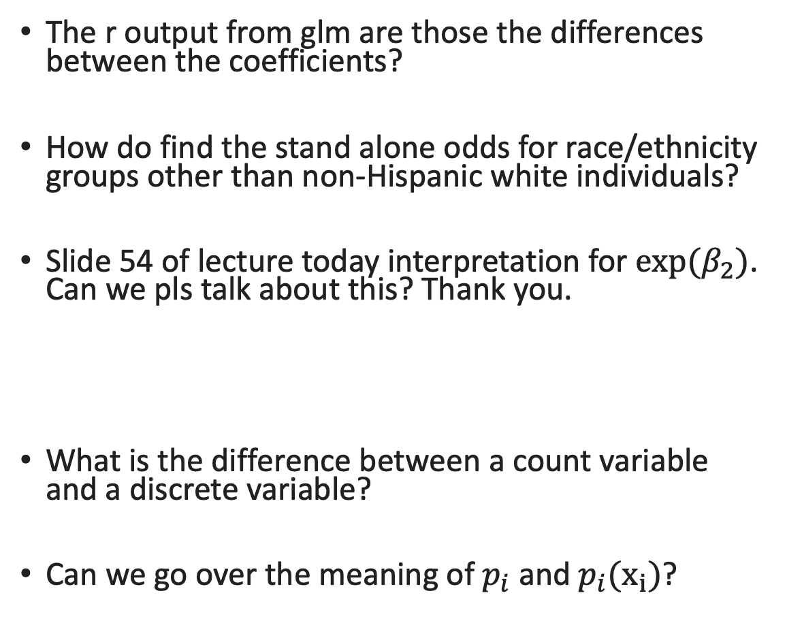
Questions from last class
The r output from glm are those the differences between the coefficients?
How do find the stand alone odds for race/ethnicity groups other than non-Hispanic white individuals?
Slide 54 of lecture today interpretation for $exp⁡(β_{2})$. Can we pls talk about this? Thank you.
What is the difference between a count variable and a discrete variable?
Can we go over the meaning of $p_{i}$ and $p_{i}(x_{i})$?
Notes:
Discrete can tkake on negative value

Slide 4
Class 6 Learning Objectives
Determine coefficient estimates using maximum likelihood estimation (MLE)
Test the significance of estimated coefficients and create confidence interval for each using three tests
Predict the probability of “success” for an individual with specific covariate values
Construct and fit a multiple logistic regression model (if time)
**For all learning objectives: start with mathematical derivation, then do in R!

Slide 5
Class 6 Learning Objectives
Determine coefficient estimates using maximum likelihood estimation (MLE)
Test the significance of estimated coefficients and create confidence interval for each using three tests
Predict the probability of “success” for an individual with specific covariate values
Construct and fit a multiple logistic regression model (if time)
**For all learning objectives: start with mathematical derivation, then do in R!

Slide 6
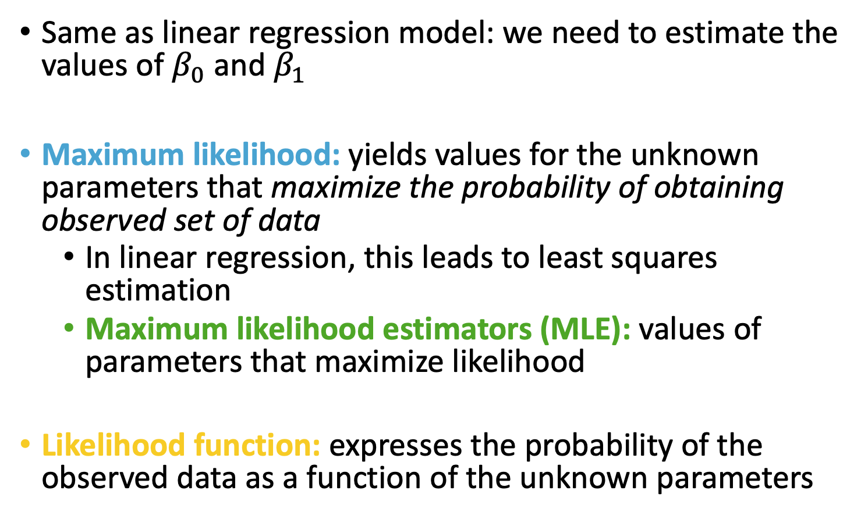
Estimation for Logistic Regression Model
Same as linear regression model: we need to estimate the values of $β_{0}$ and $β_{1}$
Maximum likelihood: yields values for the unknown parameters that maximize the probability of obtaining observed set of data
In linear regression, this leads to least squares estimation
Maximum likelihood estimators (MLE): values of parameters that maximize likelihood
Likelihood function: expresses the probability of the observed data as a function of the unknown parameters
Notes:
In ordinary linear regression, we typically use least square method for estimating $β$s. The least squares method minimize the sum of squared deviations of the observed values of Y from the predicted values.

Slide 7
Poll Everywhere Question 1

Slide 8
How to find Maximum Likelihood Estimator (MLE)?
Construct a likelihood function for an individual
Construct the likelihood function across the sample
Convert to log-likelihood
Find parameter values that maximize log-likelihood (MLEs)

Slide 9
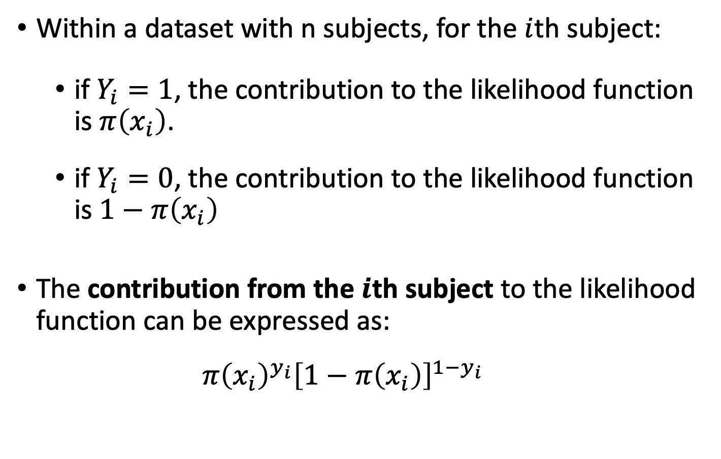
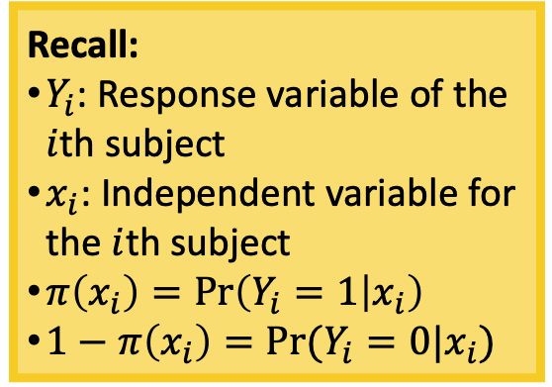
Construct a likelihood function for an individual
Within a dataset with n subjects, for the $i$th subject:
if $Y_{i}=1$, the contribution to the likelihood function is $π\left(x_{i}\right)$.
if $Y_{i}=0$, the contribution to the likelihood function is $1−π\left(x_{i}\right)$
The contribution from the $i$th subject to the likelihood function can be expressed as:
$$π{\left(x_{i}\right)}^{y_{i}}{\left[1−π\left(x_{i}\right)\right]}^{1−y_{i}}$$
Recall:
$Y_{i}$: Response variable of the $i$th subject
$x_{i}$: Independent variable for the $i$th subject
$π\left(x_{i}\right)=\operatorname{Pr}\left(Y_{i}=1 | x_{i}\right)$
$1−π\left(x_{i}\right)=Pr⁡(Y_{i}=0|x_{i})$

Slide 10
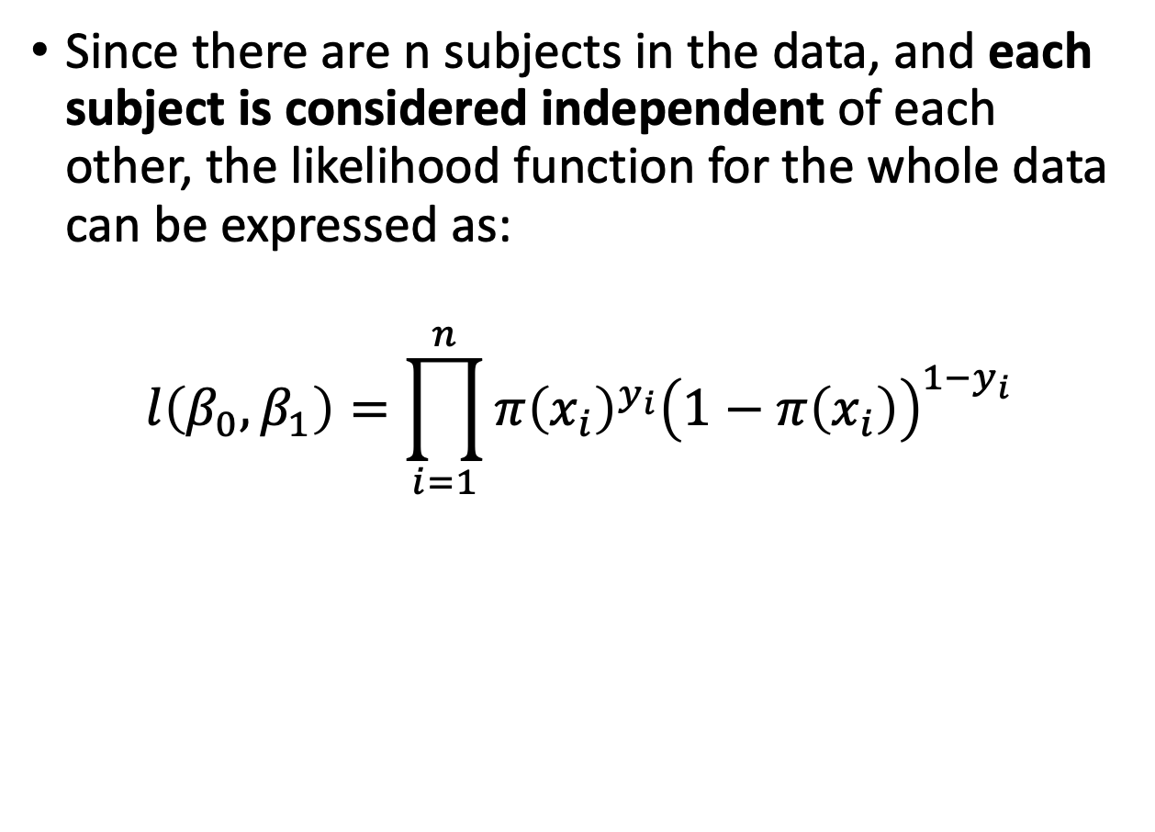
Construct the likelihood function across the sample
Since there are n subjects in the data, and each subject is considered independent of each other, the likelihood function for the whole data can be expressed as:
$$l\left(β_{0},β_{1}\right)=\prod_{i=1}^{n}{π{\left(x_{i}\right)}^{y_{i}}{\left(1−π\left(x_{i}\right)\right)}^{1−y_{i}}}$$
Recall:
$Y_{i}$: Response variable of the $i$th subject
$x_{i}$: Independent variable for the $i$th subject
$π\left(x_{i}\right)=\operatorname{Pr}\left(Y_{i}=1 | x_{i}\right)$
$1−π\left(x_{i}\right)=Pr⁡(Y_{i}=0|x_{i})$

Slide 11
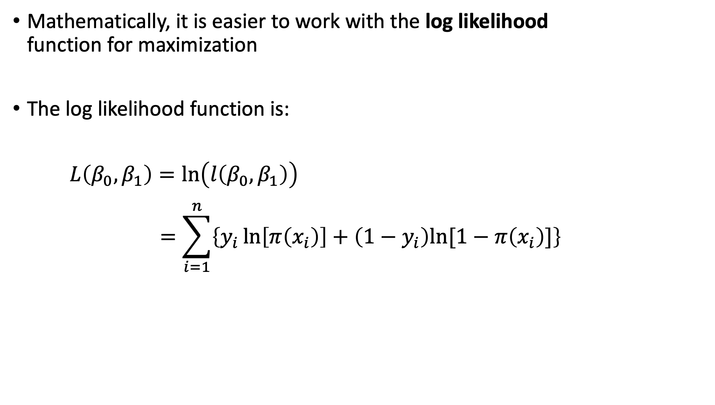
Convert to log-likelihood
Mathematically, it is easier to work with the log likelihood function for maximization
The log likelihood function is:
$L\left(β_{0},β_{1}\right)=\ln\left(l\left(β_{0},β_{1}\right)\right)$
$$=\sum_{i=1}^{n}{\left\{y_{i}\ln\left[π\left(x_{i}\right)\right]+\left(1−y_{i}\right)ln⁡[1−π\left(x_{i}\right)]\right\}}$$

Slide 12
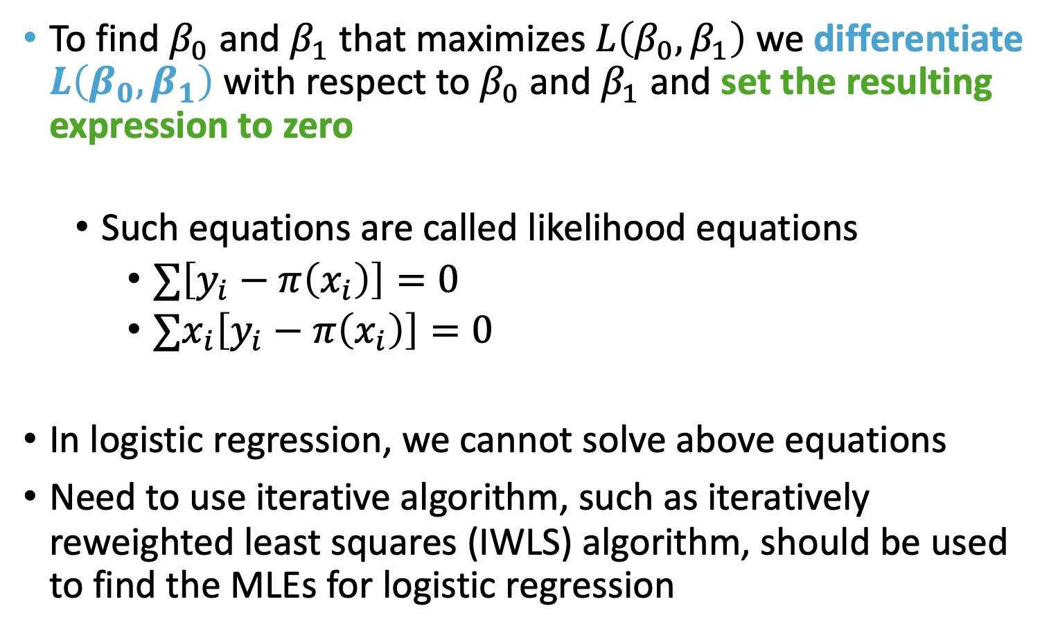
Find MLEs that maximize log-likelihood
To find $β_{0}$ and $β_{1}$ that maximizes $L\left(β_{0},β_{1}\right)$ we differentiate $L\left(β_{0},β_{1}\right)$ with respect to $β_{0}$ and $β_{1}$ and set the resulting expression to zero
Such equations are called likelihood equations
$∑\left[y_{i}−π\left(x_{i}\right)\right]=0$
$∑x_{i}\left[y_{i}−π\left(x_{i}\right)\right]=0$
In logistic regression, we cannot solve above equations
Need to use iterative algorithm, such as iteratively reweighted least squares (IWLS) algorithm, should be used to find the MLEs for logistic regression

Slide 13
Poll Everywhere Question 2

Slide 14

How do we do this in R?
glm() function automatically does MLE for you
You can explore other algorithms (other than IWLS) to maximize the likelihood
https://stats.stackexchange.com/questions/178492/which-optimization-algorithm-is-used-in-glm-function-in-r

Slide 15
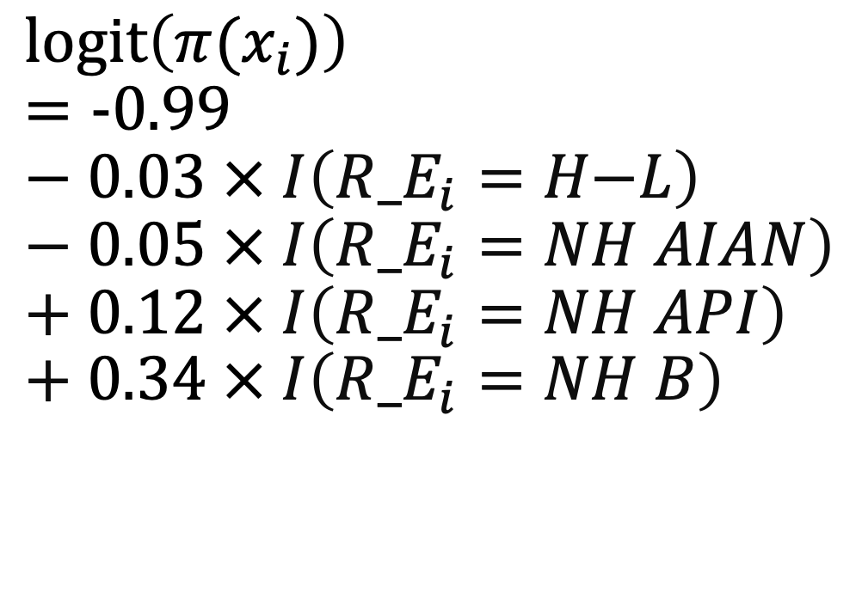
Fitted Model using MLE
$$l\text{ogit}\left(π(x_{i})\right)=\text{−}\text{0.9}9−\text{0.03} × I\left({R_E}_{i}=H\text{−}L\right)−\text{0.05} × I\left({R_E}_{i}=NH AIAN\right)+\text{0.12} × I\left({R_E}_{i}=NH API\right)+\text{0.3}4 × I\left({R_E}_{i}=NH B\right)$$

Slide 16
Class 6 Learning Objectives
Determine coefficient estimates using maximum likelihood estimation (MLE)
Test the significance of estimated coefficients and create confidence interval for each using three tests
Predict the probability of “success” for an individual with specific covariate values
Construct and fit a multiple logistic regression model (if time)
**For all learning objectives: start with mathematical derivation, then do in R!

Slide 17
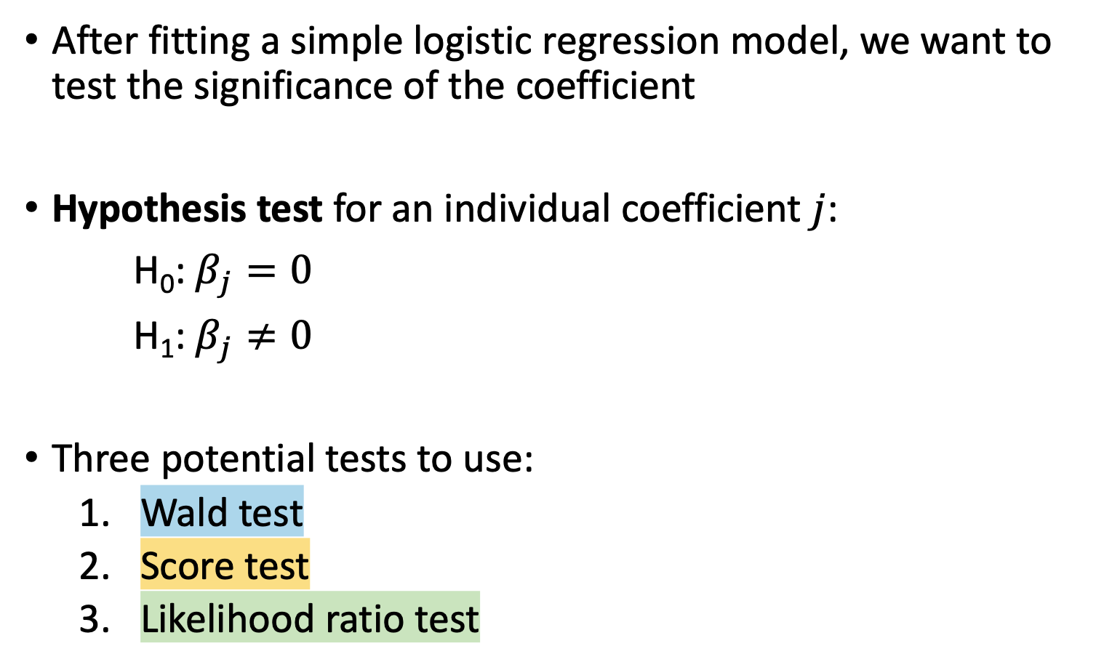
Testing for the Significance of the Coefficients
After fitting a simple logistic regression model, we want to test the significance of the coefficient
Hypothesis test for an individual coefficient $j$:
H₀: $β_{j}=0$
H₁: $β_{j}≠0$
Three potential tests to use:
Wald test
Score test
Likelihood ratio test

Slide 18
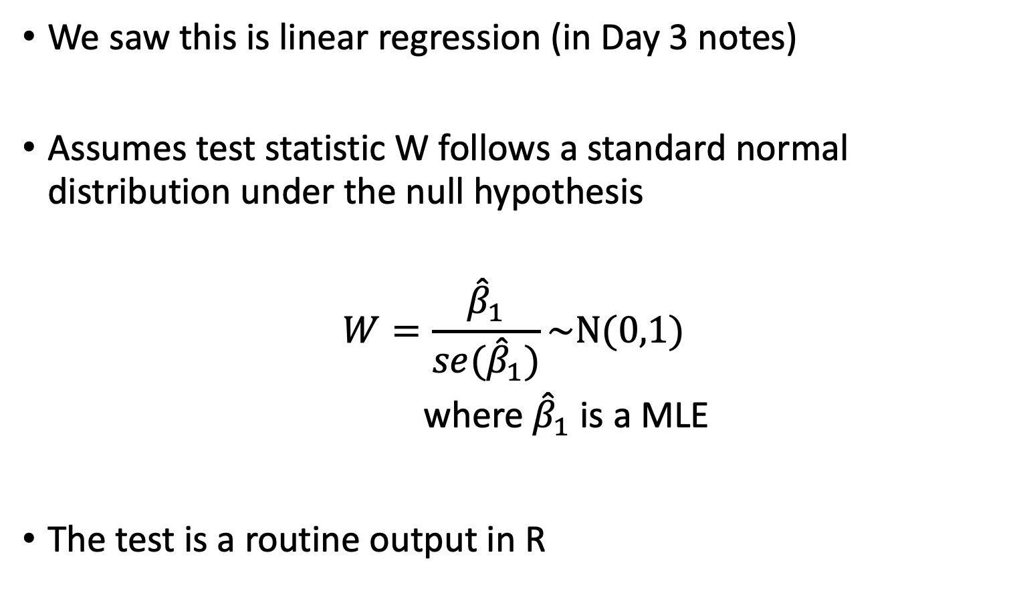
Wald Test (I)
We saw this is linear regression (in Day 3 notes)
Assumes test statistic W follows a standard normal distribution under the null hypothesis
$$W=\frac{{\hat{β}}_{1}}{se({\hat{β}}_{1})}\sim N(0,1)$$
where ${\hat{β}}_{1}$ is a MLE
The test is a routine output in R

Slide 19

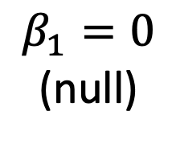


Wald Test (II)
$$L(β_{1})$$
$${\hat{β}}_{1}$$
(MLE)
$$β_{1}=0$$
(null)
$β_{1}$potential values

Slide 20
Wald Test (II)
$$L(β_{1})$$
$${\hat{β}}_{1}$$
(MLE)
$$β_{1}=0$$
(null)
$β_{1}$potential values

Slide 21
Poll Everywhere Question 3

Slide 22
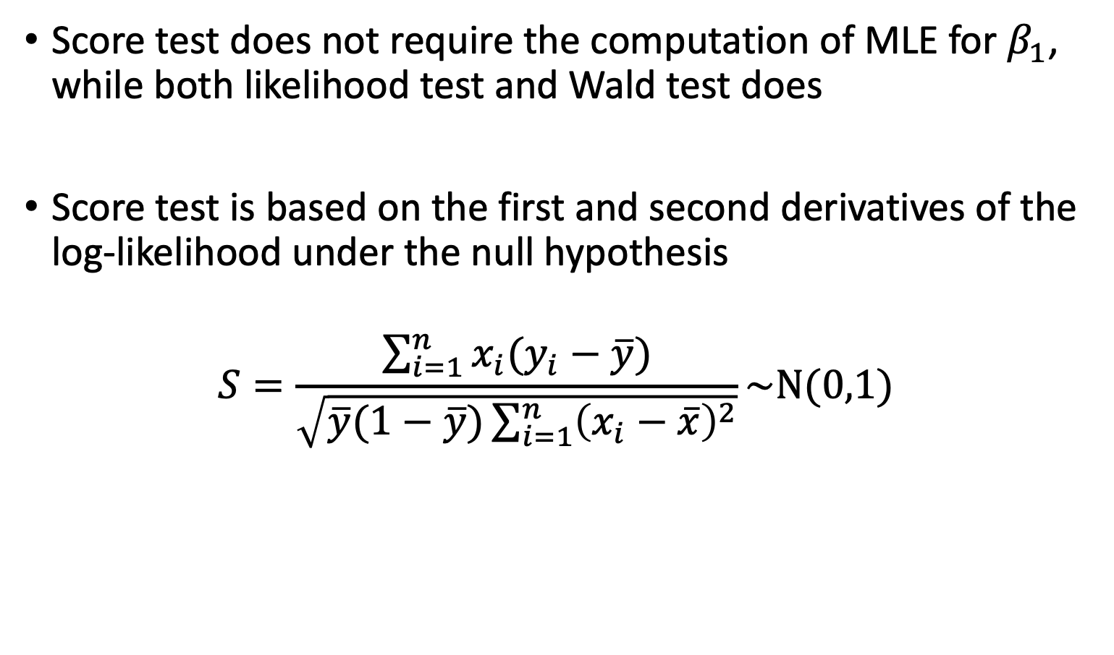
Score Test (I)
Score test does not require the computation of MLE for $β_{1}$, while both likelihood test and Wald test does
Score test is based on the first and second derivatives of the log-likelihood under the null hypothesis
$$S=\frac{\sum_{i=1}^{n}{x_{i}(y_{i}−\overline{y})}}{\sqrt{\overline{y}(1−\overline{y})\sum_{i=1}^{n}{{\left(x_{i}−\overline{x}\right)}^{2}}}}\sim N(0,1)$$

Slide 23




Graphic Illustration of the Three Tests
Score Test (II)
$$L(β_{1})$$
$${\hat{β}}_{1}$$
(MLE)
$$β_{1}=0$$
(null)
$β_{1}$potential values

Slide 24
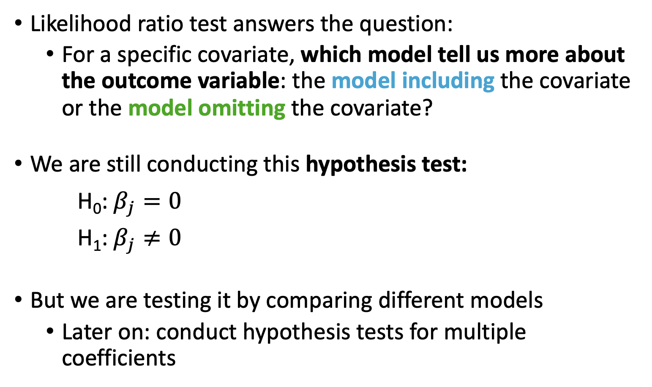
Likelihood Ratio Test (I)
Likelihood ratio test answers the question:
For a specific covariate, which model tell us more about the outcome variable: the model including the covariate or the model omitting the covariate?
We are still conducting this hypothesis test:
H₀: $β_{j}=0$
H₁: $β_{j}≠0$
But we are testing it by comparing different models
Later on: conduct hypothesis tests for multiple coefficients

Slide 25

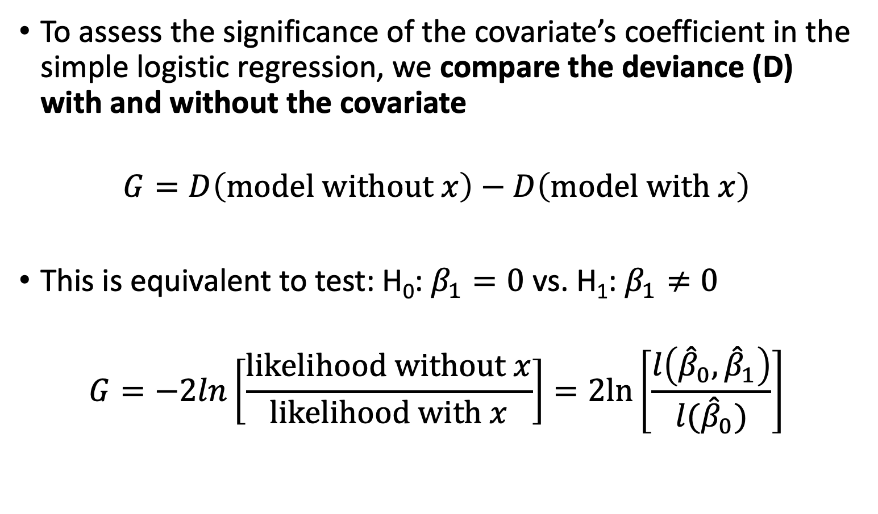
Likelihood Ratio Test (II)
To assess the significance of the covariate’s coefficient in the simple logistic regression, we compare the deviance (D) with and without the covariate
$$G=D\left(model without x\right)−D\left(model with x\right)$$
This is equivalent to test: H₀: $β_{1}=0$ vs. H₁: $β_{1}≠0$
$$G=−2ln\left[\frac{likelihood without x}{likelihood with x}\right]=2ln\left[\frac{l\left({\hat{β}}_{0},{\hat{β}}_{1}\right)}{l({\hat{β}}_{0})}\right]$$

Slide 26
LRT: what is Deviance? (I)
Deviance: quantifies the difference in likelihoods between a fitted and saturated model
Fitted model:
Your proposed fitted model
Saturated model:
A model that contains as many parameters as there are data points = perfect fit
Basically every individual has their own covariate
Perfect fit = maximum possible likelihood
All fitted models will have likelihood less than saturated model

Slide 27
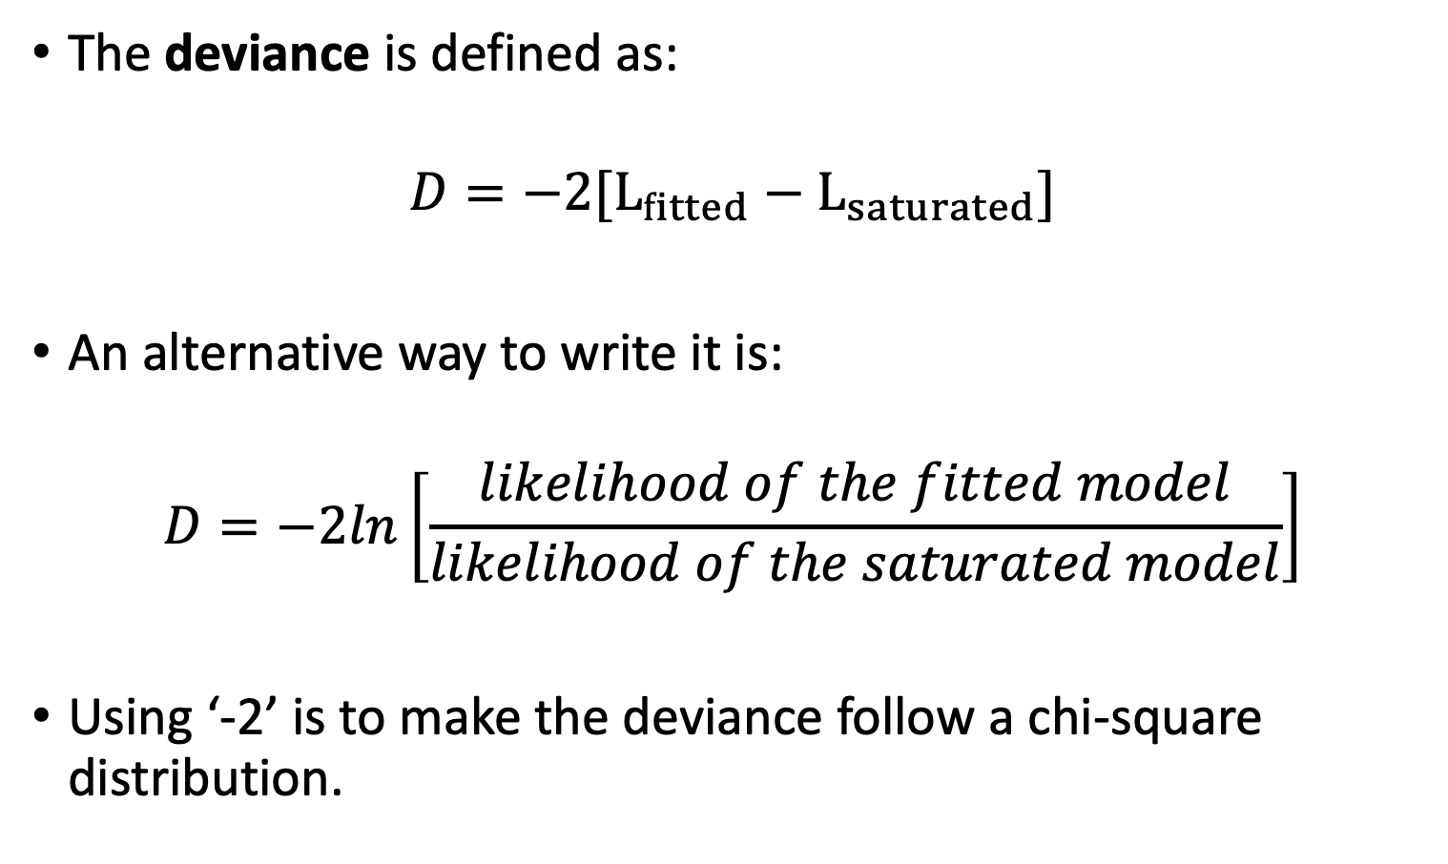
LRT: what is Deviance? (II)
The deviance is defined as:
$$D=−2[L_{fitted}−L_{saturated}]$$
An alternative way to write it is:
$$D=−2ln\left[\frac{likelihood of the fitted model}{likelihood of the saturated model}\right]$$
Using ‘-2’ is to make the deviance follow a chi-square distribution.

Slide 28
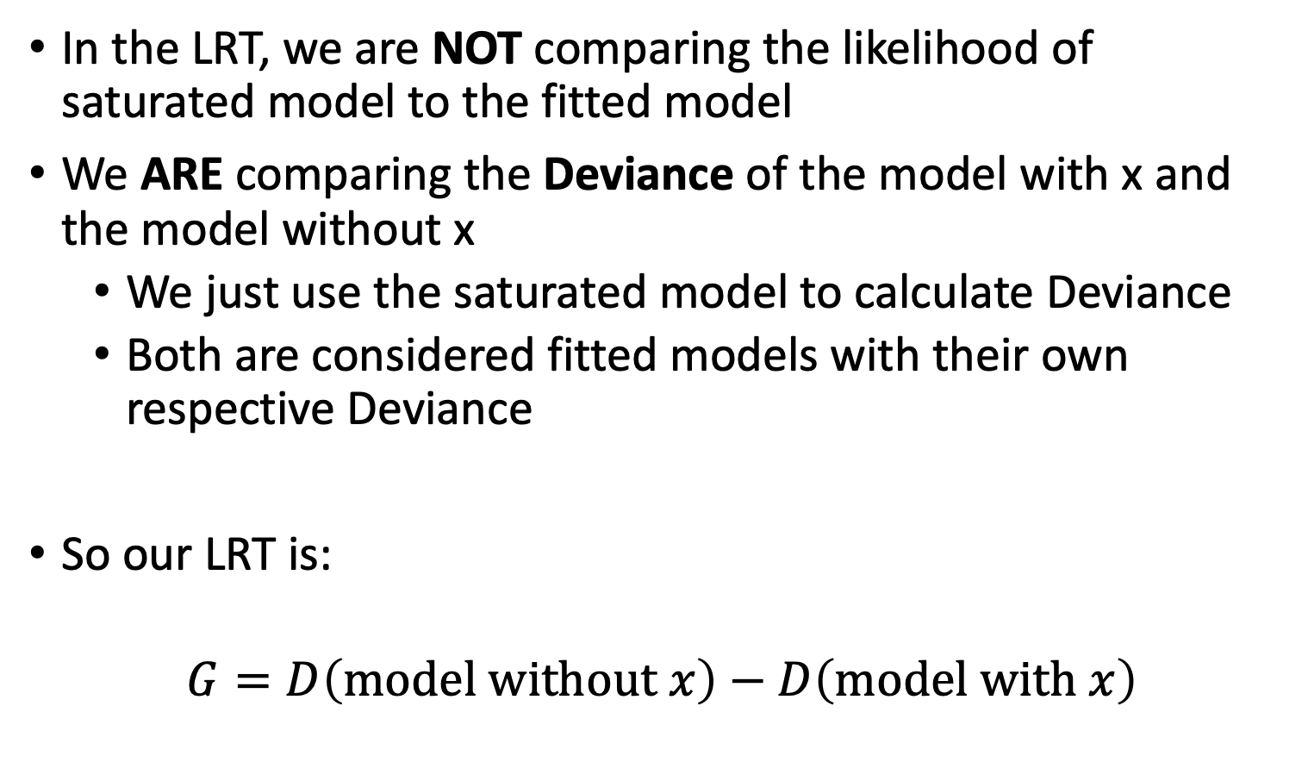
Deviance to Likelihood Ratio Test
In the LRT, we are NOT comparing the likelihood of saturated model to the fitted model
We ARE comparing the Deviance of the model with x and the model without x
We just use the saturated model to calculate Deviance
Both are considered fitted models with their own respective Deviance
So our LRT is:
$$G=D\left(model without x\right)−D\left(model with x\right)$$

Slide 29
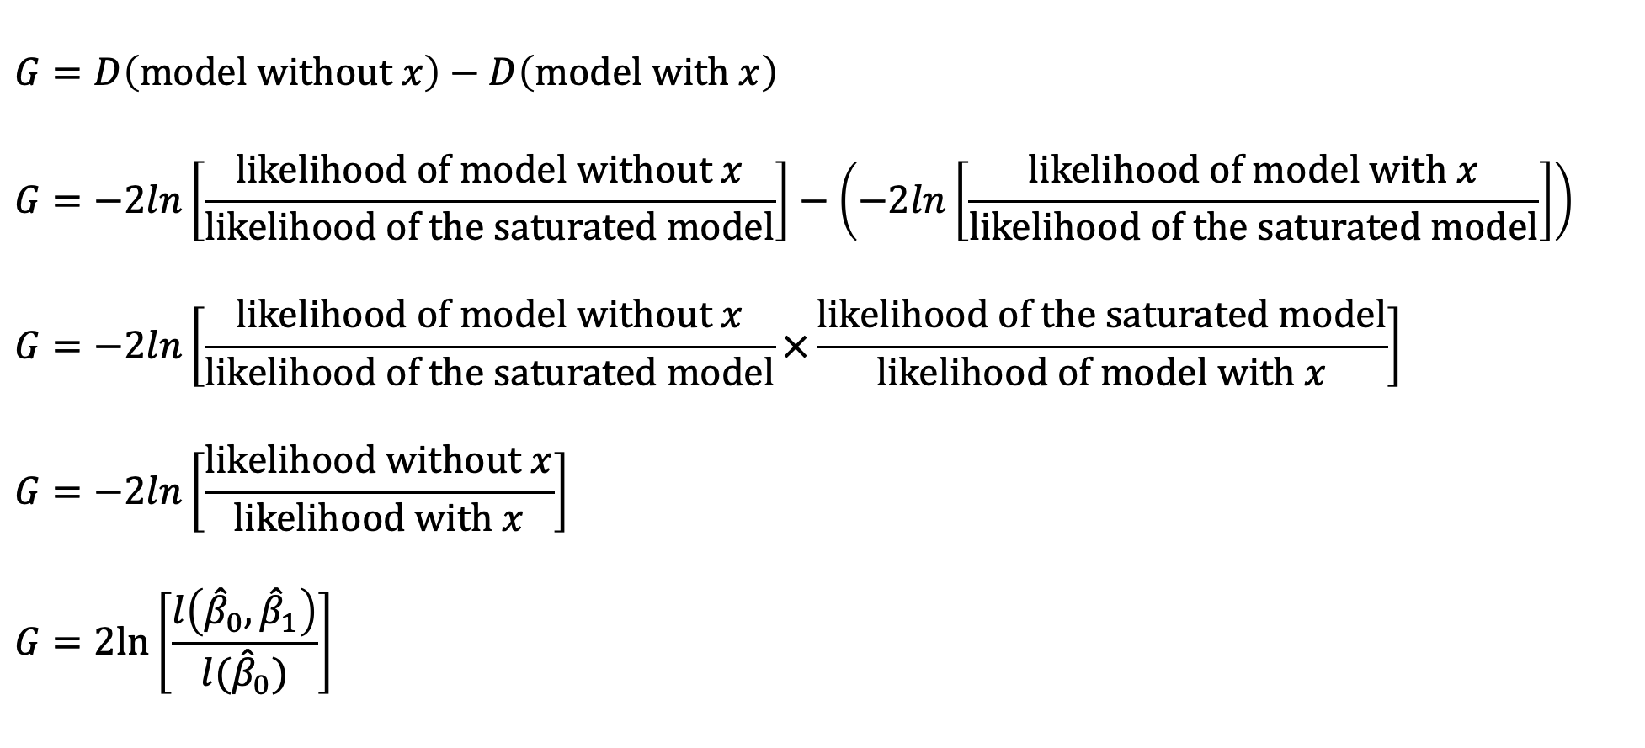
For reference
$$G=D\left(model without x\right)−D\left(model with x\right)$$
$$G=−2ln\left[\frac{likelihood of model without x}{likelihood of the saturated model}\right]−\left(−2ln\left[\frac{likelihood of model with x}{likelihood of the saturated model}\right]\right)$$
$$G=−2ln\left[\frac{likelihood of model without x}{likelihood of the saturated model}×\frac{likelihood of the saturated model}{likelihood of model with x}\right]$$
$$G=−2ln\left[\frac{likelihood without x}{likelihood with x}\right]$$
$$G=2ln\left[\frac{l\left({\hat{β}}_{0},{\hat{β}}_{1}\right)}{l({\hat{β}}_{0})}\right]$$

Slide 30

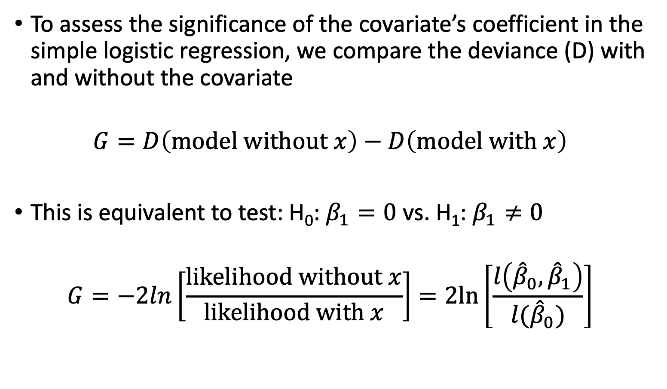
Likelihood Ratio Test (II)
To assess the significance of the covariate’s coefficient in the simple logistic regression, we compare the deviance (D) with and without the covariate
$$G=D\left(model without x\right)−D\left(model with x\right)$$
This is equivalent to test: H₀: $β_{1}=0$ vs. H₁: $β_{1}≠0$
$$G=−2ln\left[\frac{likelihood without x}{likelihood with x}\right]=2ln\left[\frac{l\left({\hat{β}}_{0},{\hat{β}}_{1}\right)}{l({\hat{β}}_{0})}\right]$$

Slide 31
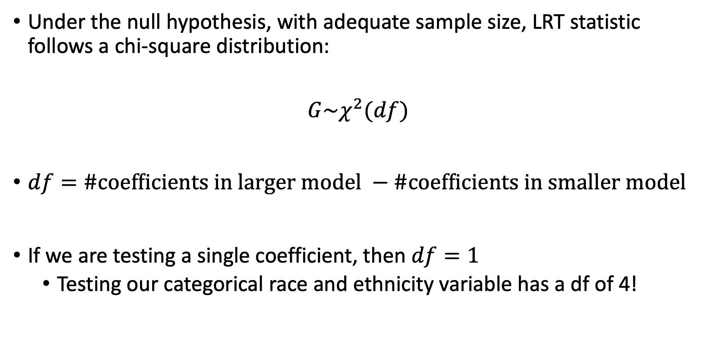
Likelihood Ratio Test (III)
Under the null hypothesis, with adequate sample size, LRT statistic follows a chi-square distribution:
$$G\sim χ^{2}(df)$$
$df=\#coefficients in larger model −\#coefficients in smaller model$
If we are testing a single coefficient, then $df=1$
Testing our categorical race and ethnicity variable has a df of 4!

Slide 32
Poll Everywhere Question 4

Slide 33

Likelihood Ratio Test (IV)
$$L(β_{1})$$
$${\hat{β}}_{1}$$
(MLE)
$$β_{1}=0$$
(null)
$β_{1}$potential values

Slide 34

All three tests together
LRT
$$L(β_{1})$$
Score Test
Wald Test
$${\hat{β}}_{1}$$
(MLE)
$$β_{1}=0$$
(null)
$β_{1}$potential values
UCLA FAQ on Tests

Slide 35
Which test to use?
All three tests are asymptotically equivalent
As sample approaches infinity
For testing significance of single covariate coefficient:
LRT: most people’s recommendation
Wald and score are only approximations of LRT
For smaller samples, LRT better
Wald test is very convenient
Automatically performed in R
Does not need to estimate two models (LRT does)
Good for testing separate coefficients for a categorical covariate
Score test
Does not need to estimate two models (LRT does)
I don’t really see people use this…

Slide 36
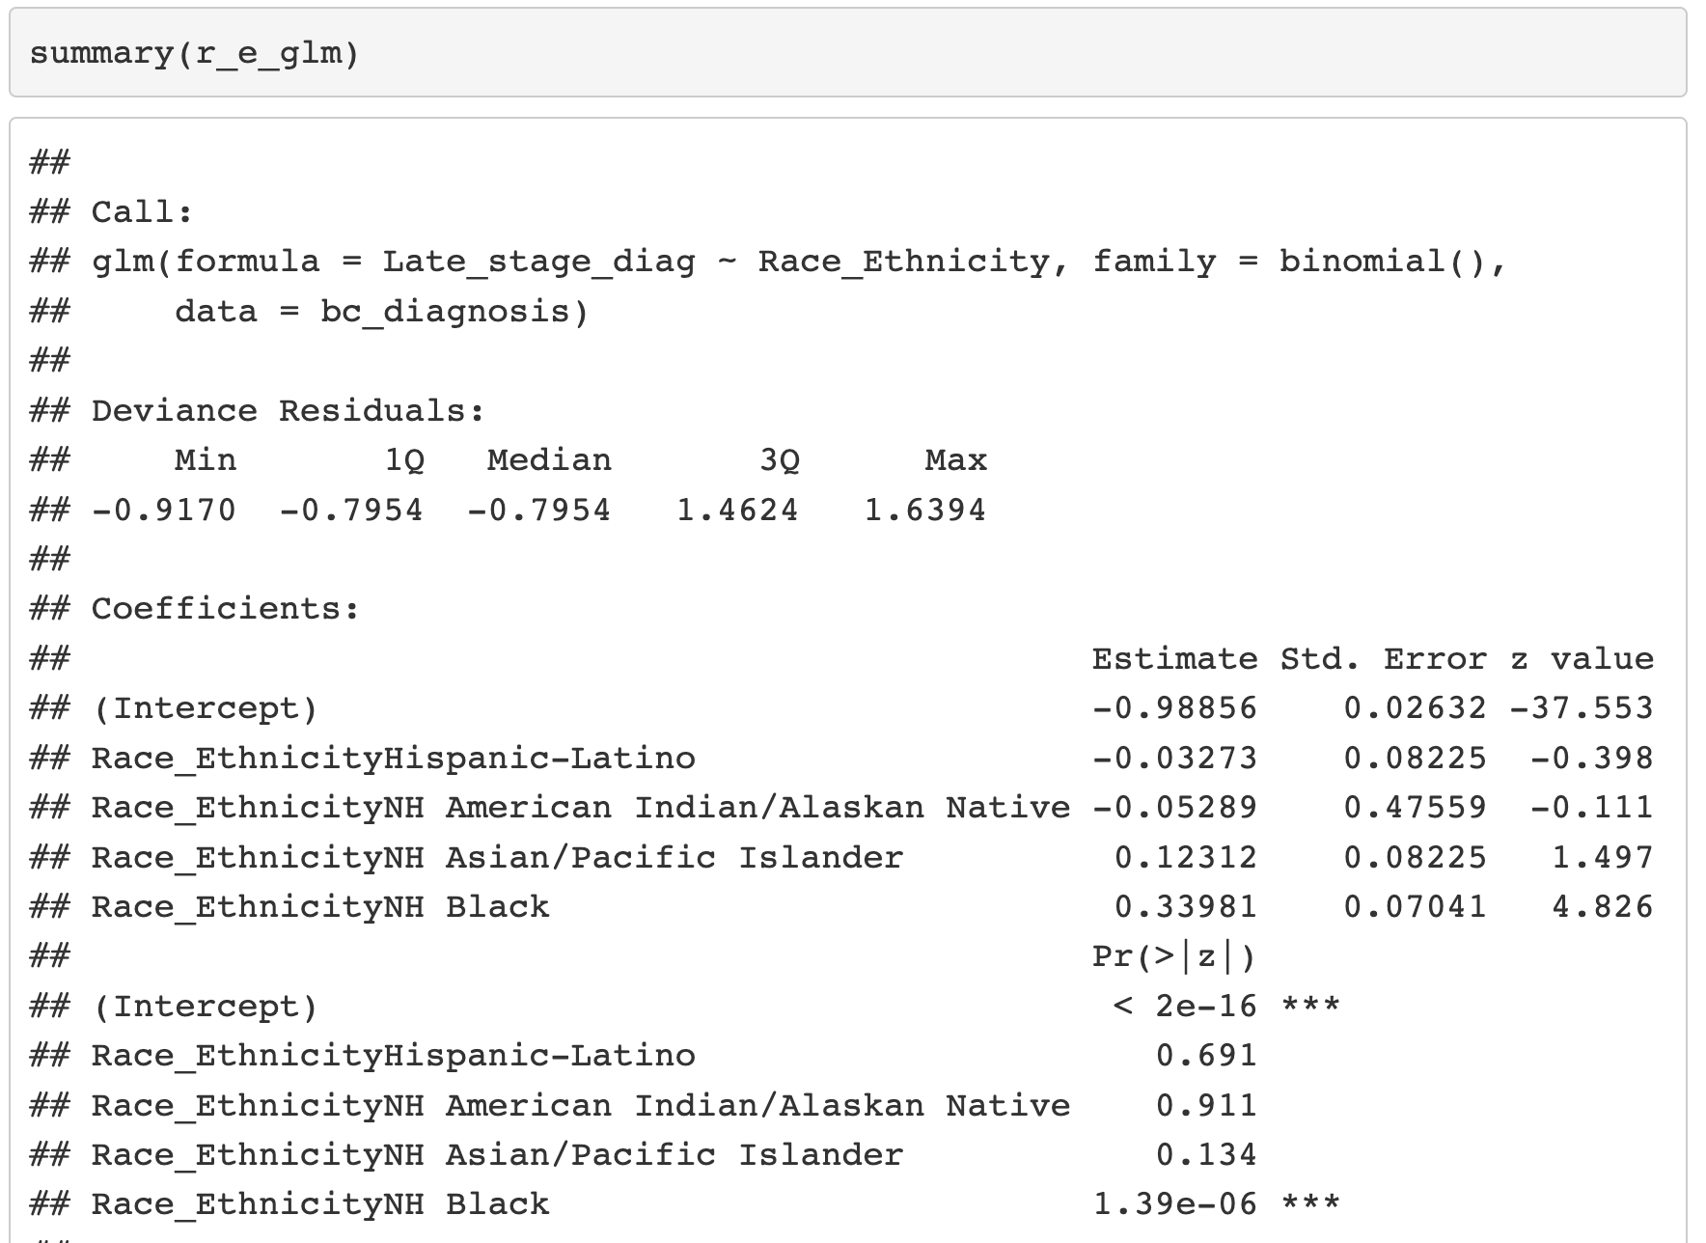
Wald Test in R

Slide 37
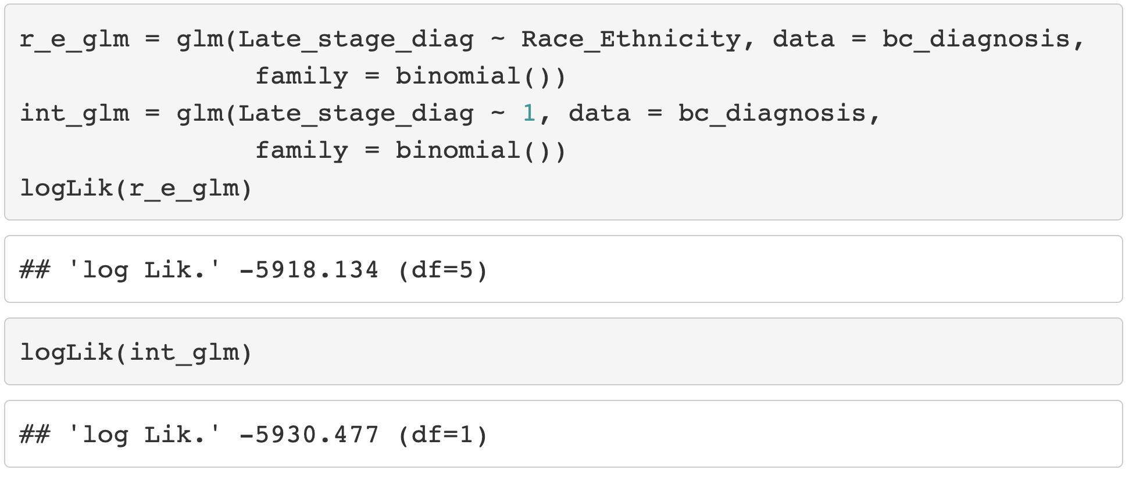
Likelihood Ratio Test in R (I)

Slide 38
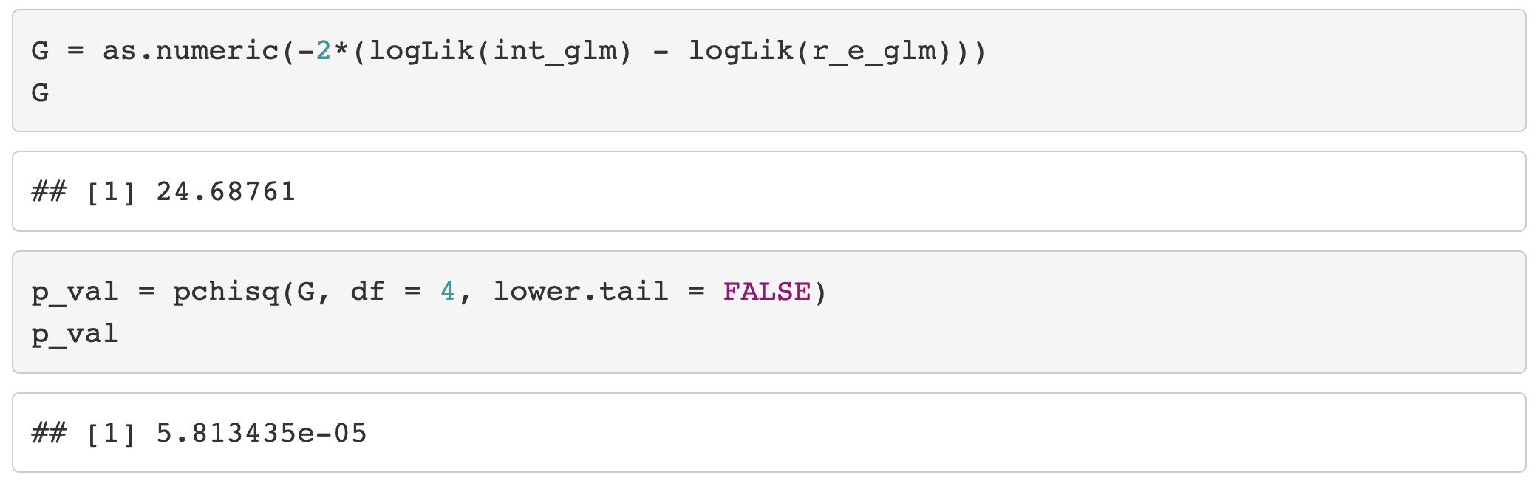
Likelihood Ratio Test in R (II)

Slide 39
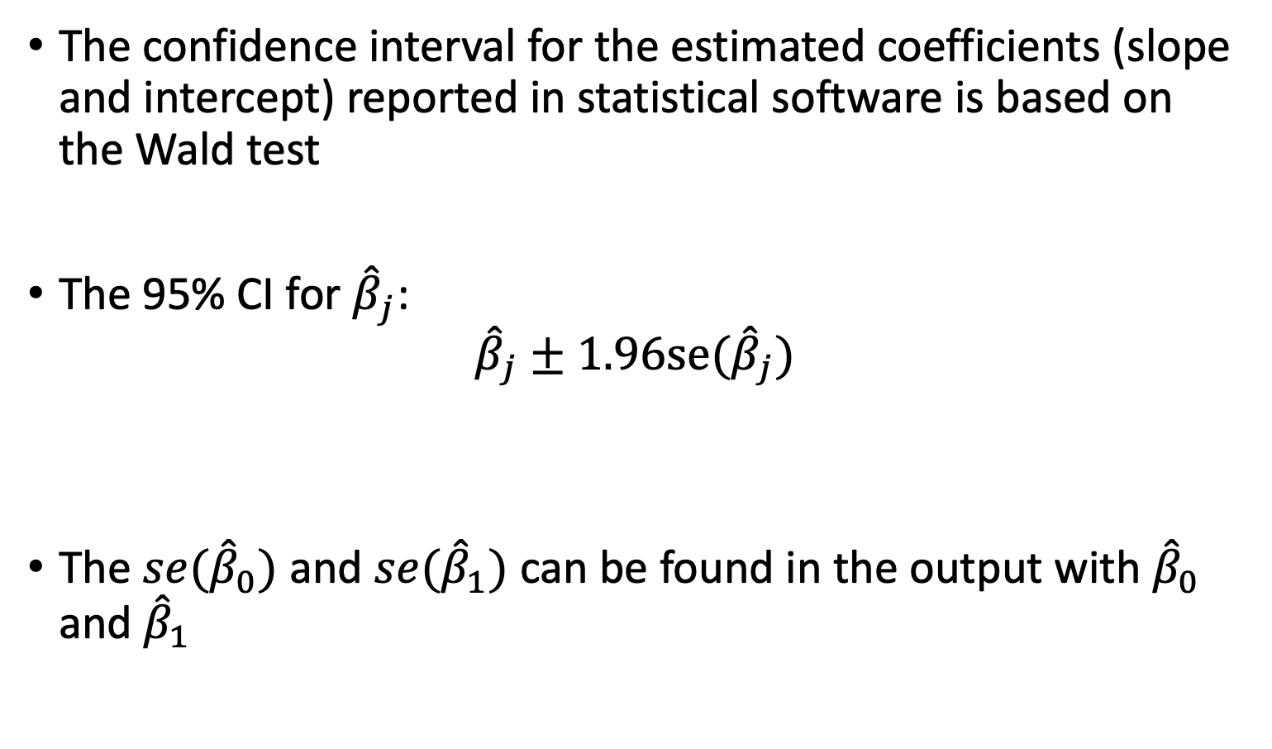
Confidence Interval for the Coefficients (I)
The confidence interval for the estimated coefficients (slope and intercept) reported in statistical software is based on the Wald test
The 95% CI for ${\hat{β}}_{j}$:
$${\hat{β}}_{j}±1.96se({\hat{β}}_{j})$$
The $se({\hat{β}}_{0})$ and $se({\hat{β}}_{1})$ can be found in the output with ${\hat{β}}_{0}$ and ${\hat{β}}_{1}$

Slide 40
Poll Everywhere Question 5

Slide 41
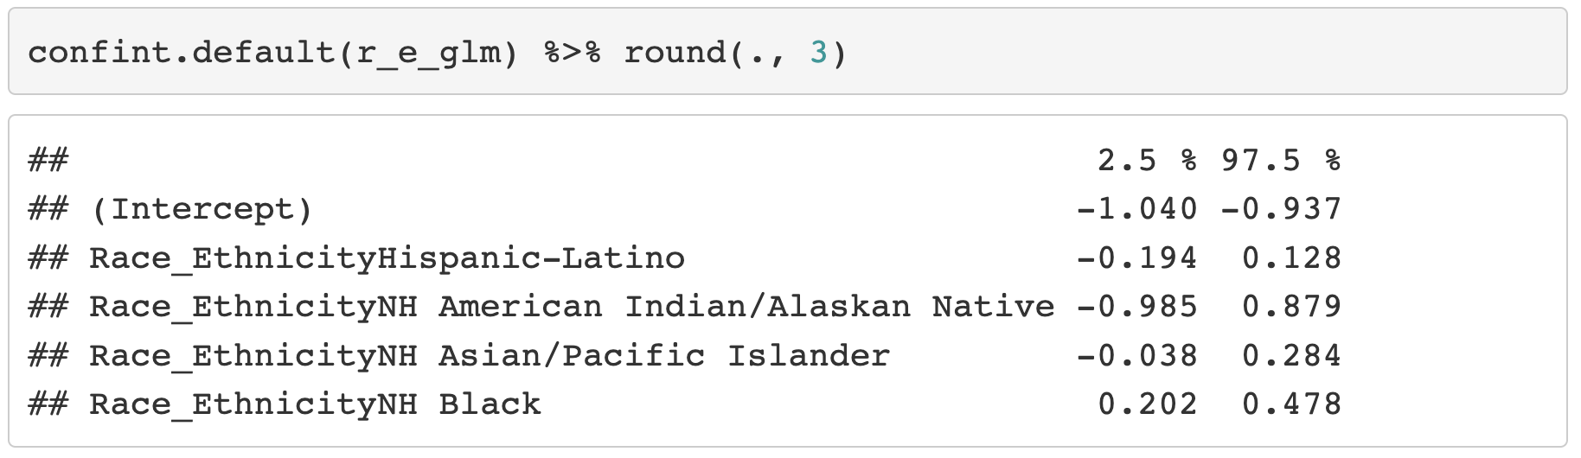
Confidence Interval for the Coefficients (II)
Note: confint() uses profile likelihood method for CI
For Wald confidence interval, should use confint.default()

Slide 42
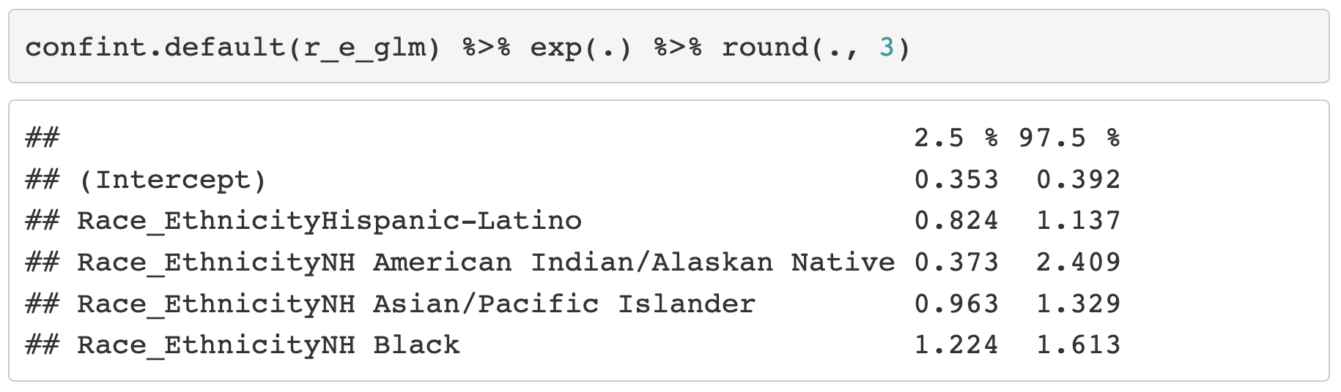
Confidence Interval for the Odds Ratio
As we saw in last class, we take the exponential of the coefficient to get the odds ratio
We can do the same for the confidence interval

Slide 43
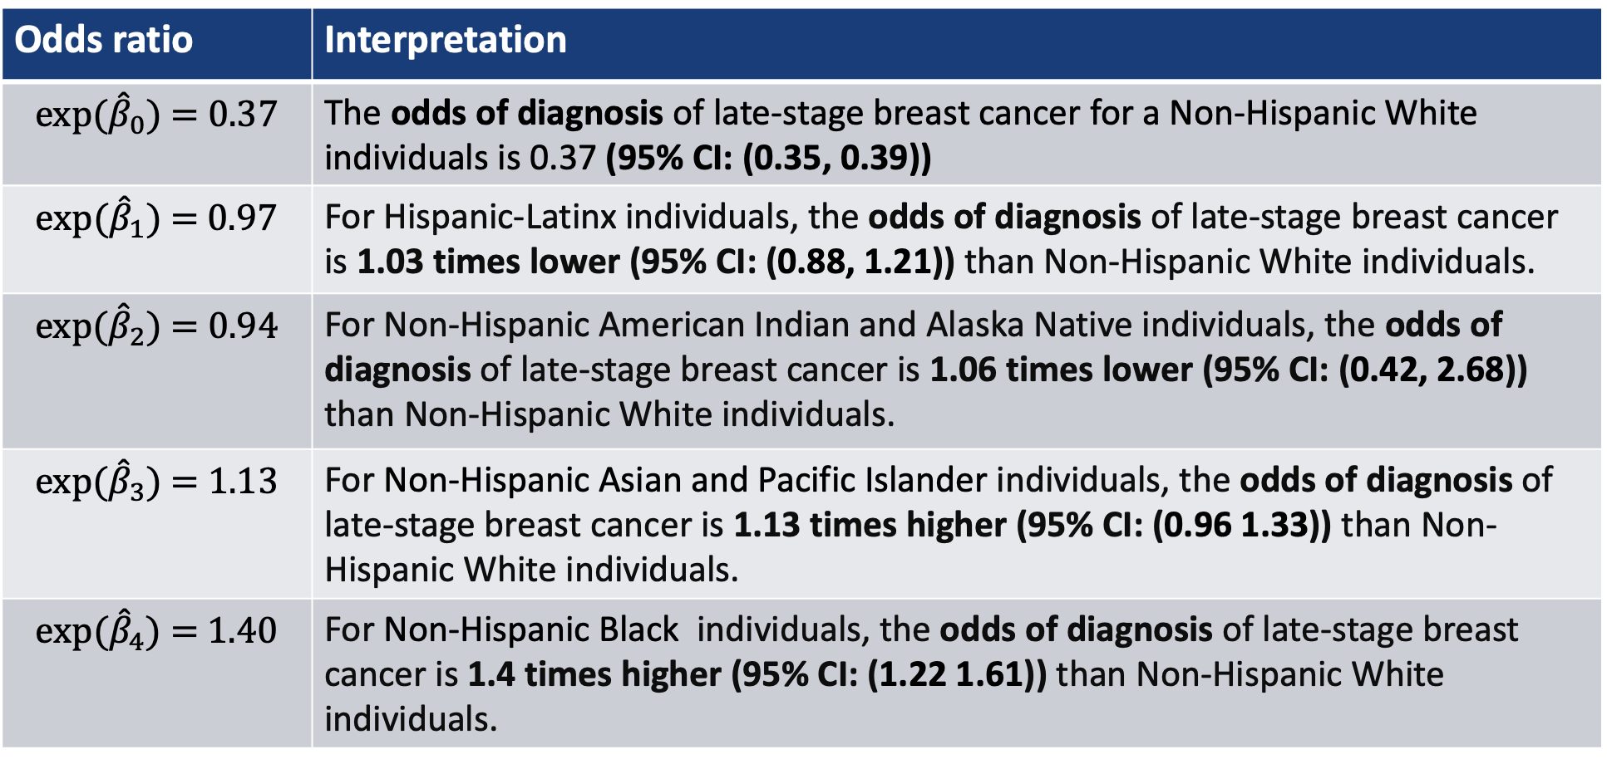
Interpretation of odds ratios (categorical covariate)
Reference
Odds ratio | Interpretation
$${exp⁡(\hat{β}}_{0})\text{ = 0.37}$$ | The odds of diagnosis of late-stage breast cancer for a Non-Hispanic White individuals is 0.37 (95% CI: (0.35, 0.39))
$${exp⁡(\hat{β}}_{1})\text{ = 0.97}$$ | For Hispanic-Latinx individuals, the odds of diagnosis of late-stage breast cancer is 1.03 times lower (95% CI: (0.88, 1.21)) than Non-Hispanic White individuals.
$${exp⁡(\hat{β}}_{2})\text{ = 0.94}$$ | For Non-Hispanic American Indian and Alaska Native individuals, the odds of diagnosis of late-stage breast cancer is 1.06 times lower (95% CI: (0.42, 2.68)) than Non-Hispanic White individuals.
$${exp⁡(\hat{β}}_{3})\text{ = 1.13}$$ | For Non-Hispanic Asian and Pacific Islander individuals, the odds of diagnosis of late-stage breast cancer is 1.13 times higher (95% CI: (0.96 1.33)) than Non-Hispanic White individuals.
$${exp⁡(\hat{β}}_{4})\text{ = 1.40}$$ | For Non-Hispanic Black individuals, the odds of diagnosis of late-stage breast cancer is 1.4 times higher (95% CI: (1.22 1.61)) than Non-Hispanic White individuals.

Slide 44
Class 6 Learning Objectives
Determine coefficient estimates using maximum likelihood estimation (MLE)
Test the significance of estimated coefficients and create confidence interval for each using three tests
Predict the probability of “success” for an individual with specific covariate values
Construct and fit a multiple logistic regression model (if time)
**For all learning objectives: start with mathematical derivation, then do in R!

Slide 45
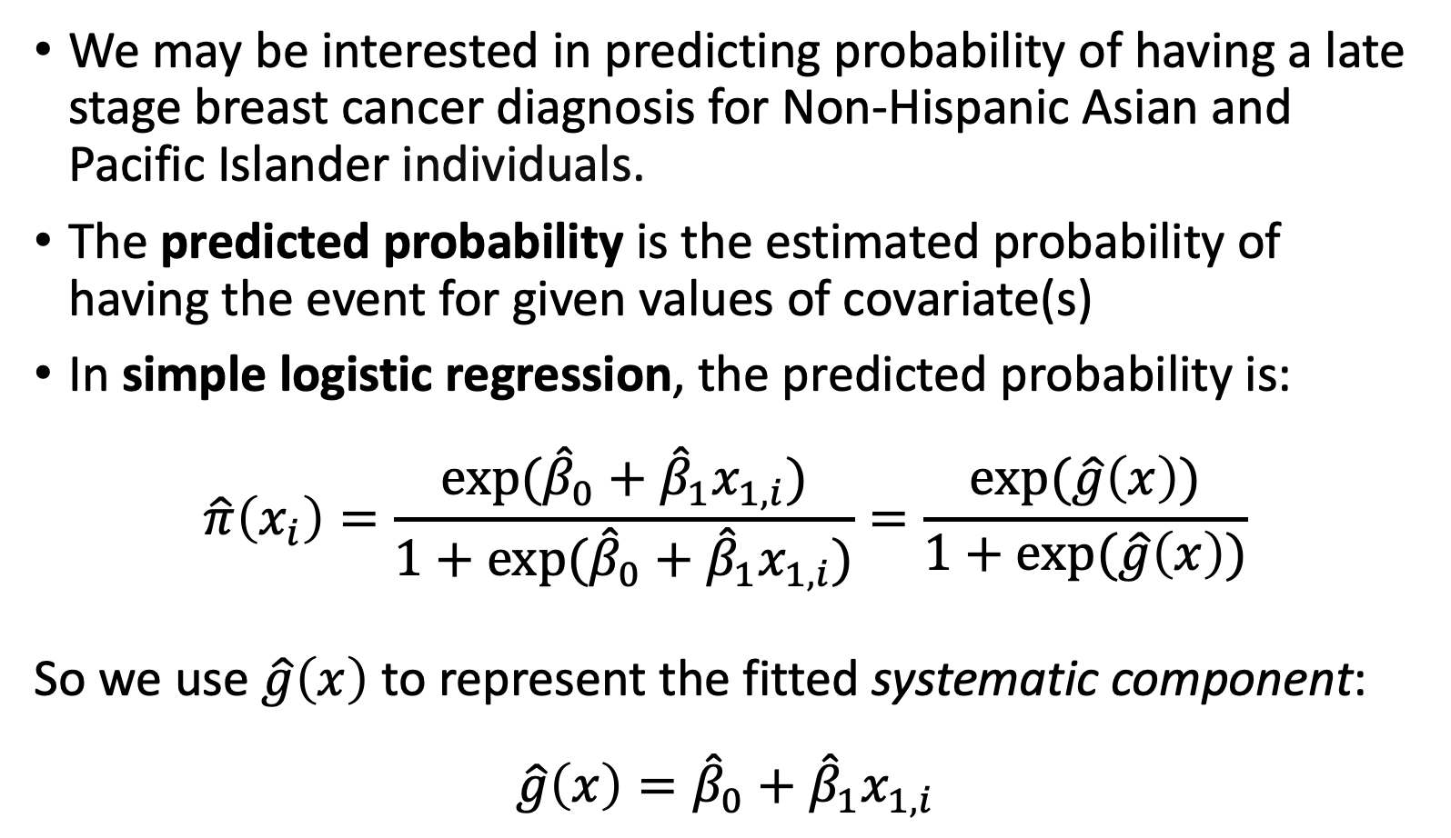
Predicted Probability (I)
We may be interested in predicting probability of having a late stage breast cancer diagnosis for Non-Hispanic Asian and Pacific Islander individuals.
The predicted probability is the estimated probability of having the event for given values of covariate(s)
In simple logistic regression, the predicted probability is:
$$\hat{π}\left(x_{i}\right)=\frac{exp⁡({\hat{β}}_{0}+{\hat{β}}_{1}x_{1,i})}{1+exp⁡({\hat{β}}_{0}+{\hat{β}}_{1}x_{1,i})}=\frac{exp⁡(\hat{g}\left(x\right))}{1+exp⁡(\hat{g}\left(x\right))}$$
So we use $\hat{g}\left(x\right)$ to represent the fitted systematic component:
$$\hat{g}\left(x\right)={\hat{β}}_{0}+{\hat{β}}_{1}x_{1,i}$$

Slide 46
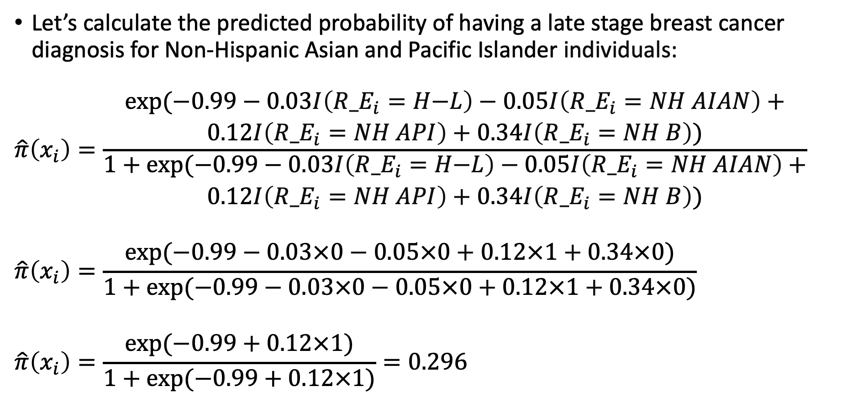
Predicted Probability (II)
Let’s calculate the predicted probability of having a late stage breast cancer diagnosis for Non-Hispanic Asian and Pacific Islander individuals:
$$\hat{π}\left(x_{i}\right)=\frac{\begin{aligned}exp⁡(\text{−}\text{0.9}9−\text{0.03}I\left({R_E}_{i}=H\text{−}L\right)−\text{0.05}I\left({R_E}_{i}=NH AIAN\right)+ \\ \text{0.12}I\left({R_E}_{i}=NH API\right)+\text{0.3}4I\left({R_E}_{i}=NH B\right))\end{aligned}}{\begin{aligned}1+exp⁡(\text{−}\text{0.9}9−\text{0.03}I\left({R_E}_{i}=H\text{−}L\right)−\text{0.05}I\left({R_E}_{i}=NH AIAN\right)+ \\ \text{0.12}I\left({R_E}_{i}=NH API\right)+\text{0.3}4I\left({R_E}_{i}=NH B\right))\end{aligned}}$$
$$\hat{π}\left(x_{i}\right)=\frac{exp⁡(\text{−}\text{0.9}9−\text{0.03}×0−\text{0.05}×0+\text{0.12}×1+\text{0.3}4×0)}{1+exp⁡(\text{−}\text{0.9}9−\text{0.03}×0−\text{0.05}×0+\text{0.12}×1+\text{0.3}4×0)}$$
$$\hat{π}\left(x_{i}\right)=\frac{exp⁡(−0.99+\text{0.12}×1)}{1+exp⁡(−0.99+\text{0.12}×1)}=0.296$$

Slide 47
Predicted Probability (III)
Predicted probability is NOT our predicted outcome
We cannot interpret it as the predicted Y for individuals with certain covariate values
Example: our predicted probability does not tell us that one individual is or is not diagnosed with late stage breast cancer
The 0.296 is the estimate of the mean (i.e., proportion) of Non-Hispanic Asian and Pacific Islander individuals who are diagnosed with late stage breast cancer

Slide 48
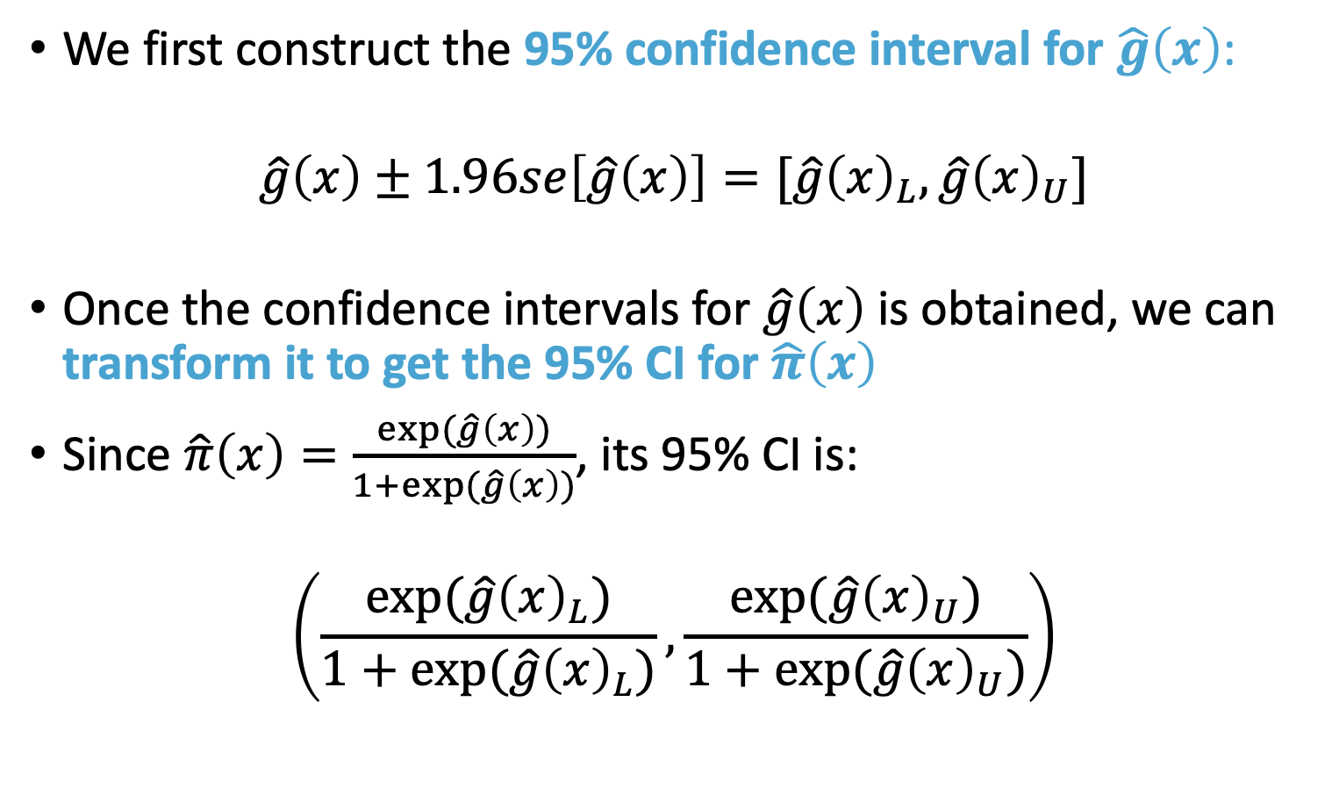
Confidence Interval for Predicted Probability (I)
We first construct the 95% confidence interval for $\hat{g}\left(x\right)$:
$$\hat{g}\left(x\right)±1.96se\left[\hat{g}\left(x\right)\right]=[\hat{g}{\left(x\right)}_{L},\hat{g}{\left(x\right)}_{U}]$$
Once the confidence intervals for $\hat{g}\left(x\right)$ is obtained, we can transform it to get the 95% CI for $\hat{π}\left(x\right)$
Since $\hat{π}\left(x\right)=\frac{exp⁡(\hat{g}\left(x\right))}{1+exp⁡(\hat{g}\left(x\right))}$, its 95% CI is:
$$\left(\frac{exp⁡(\hat{g}{\left(x\right)}_{L})}{1+exp⁡(\hat{g}{\left(x\right)}_{L})},\frac{exp⁡(\hat{g}{\left(x\right)}_{U})}{1+exp⁡(\hat{g}{\left(x\right)}_{U})}\right)$$

Slide 49
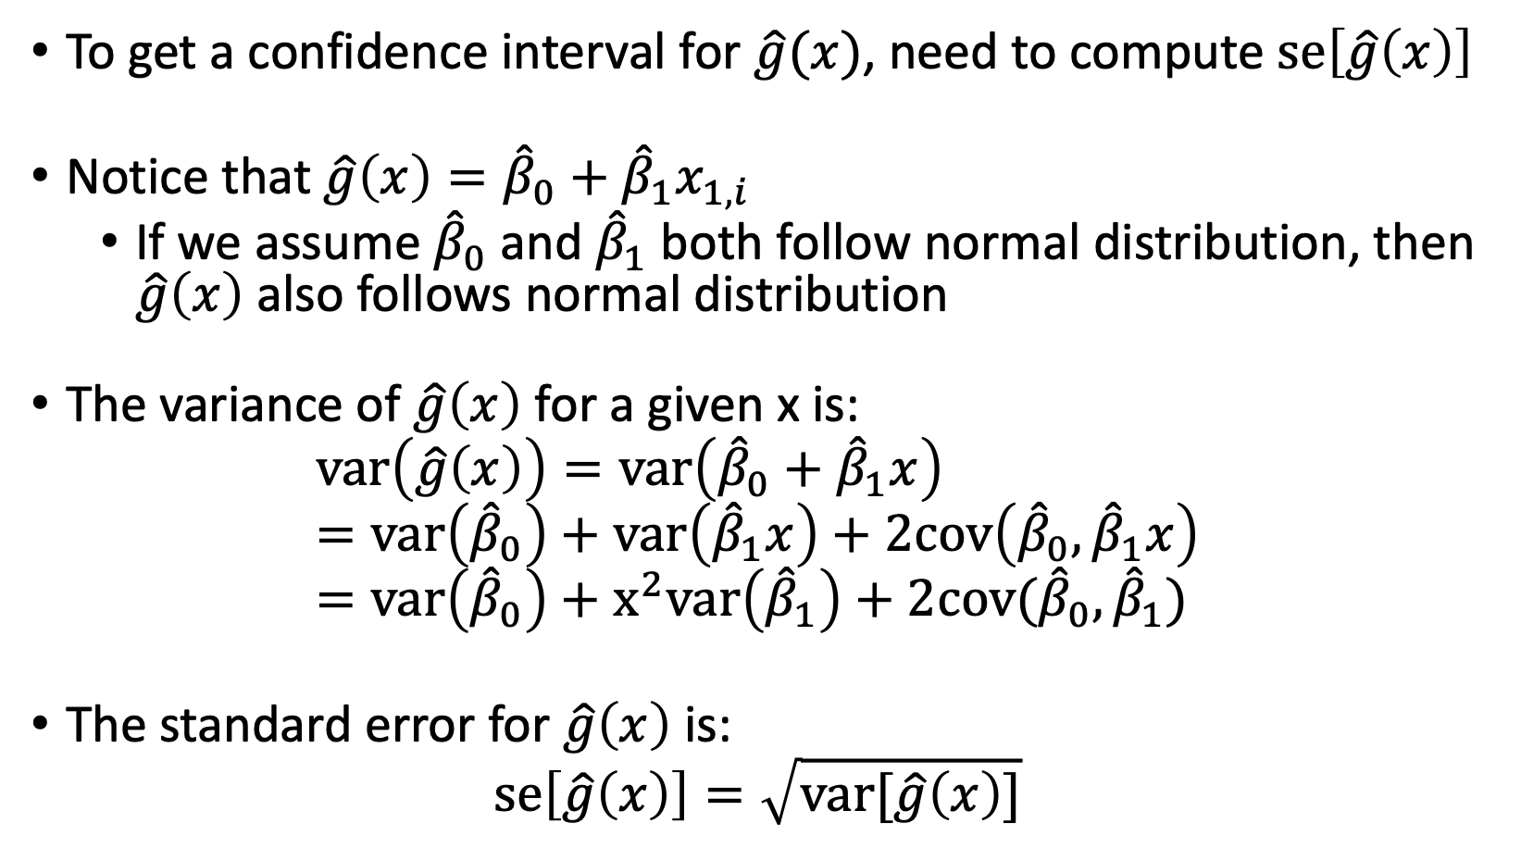
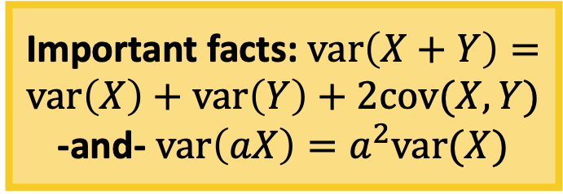
Confidence Interval for Predicted Probability (II)
To get a confidence interval for $\hat{g}(x)$, need to compute $se\left[\hat{g}\left(x\right)\right]$
Notice that $\hat{g}\left(x\right)={\hat{β}}_{0}+{\hat{β}}_{1}x_{1,i}$
If we assume ${\hat{β}}_{0}$ and ${\hat{β}}_{1}$ both follow normal distribution, then $\hat{g}\left(x\right)$ also follows normal distribution
The variance of $\hat{g}\left(x\right)$ for a given x is:
$$var\left(\hat{g}\left(x\right)\right)=var\left({\hat{β}}_{0}+{\hat{β}}_{1}x\right)=var\left({\hat{β}}_{0}\right)+var\left({\hat{β}}_{1}x\right)+2cov\left({\hat{β}}_{0},{\hat{β}}_{1}x\right)=var\left({\hat{β}}_{0}\right)+x^{2}var\left({\hat{β}}_{1}\right)+2cov({\hat{β}}_{0},{\hat{β}}_{1})$$
The standard error for $\hat{g}\left(x\right)$ is:
$$se\left[\hat{g}\left(x\right)\right]=\sqrt{var[\hat{g}\left(x\right)]}$$
Important facts: $var\left(X+Y\right)=var\left(X\right)+var\left(Y\right)+2cov(X, Y)$
-and- $var\left(aX\right)=a^{2}var(X)$

Slide 50
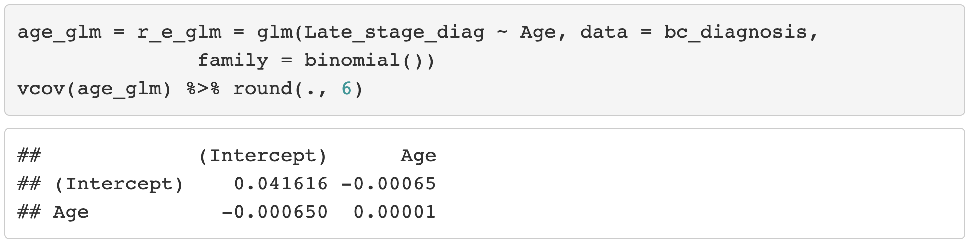

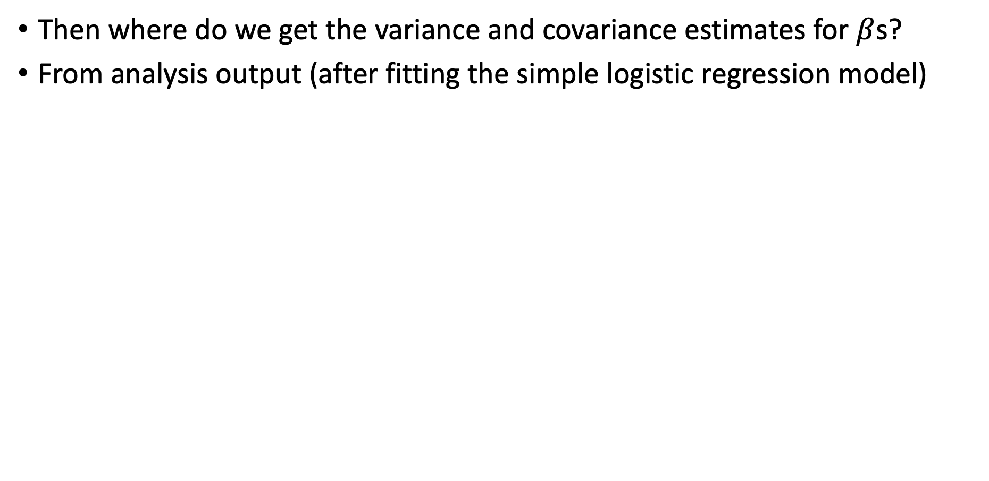


Confidence Interval for Predicted Probability (III)
Then where do we get the variance and covariance estimates for $β$s?
From analysis output (after fitting the simple logistic regression model)
$$cov({\hat{β}}_{0},{\hat{β}}_{1})$$
$$var\left({\hat{β}}_{0}\right)$$
$$var\left({\hat{β}}_{1}\right)$$

Slide 51
Poll Everywhere Question 6

Slide 52
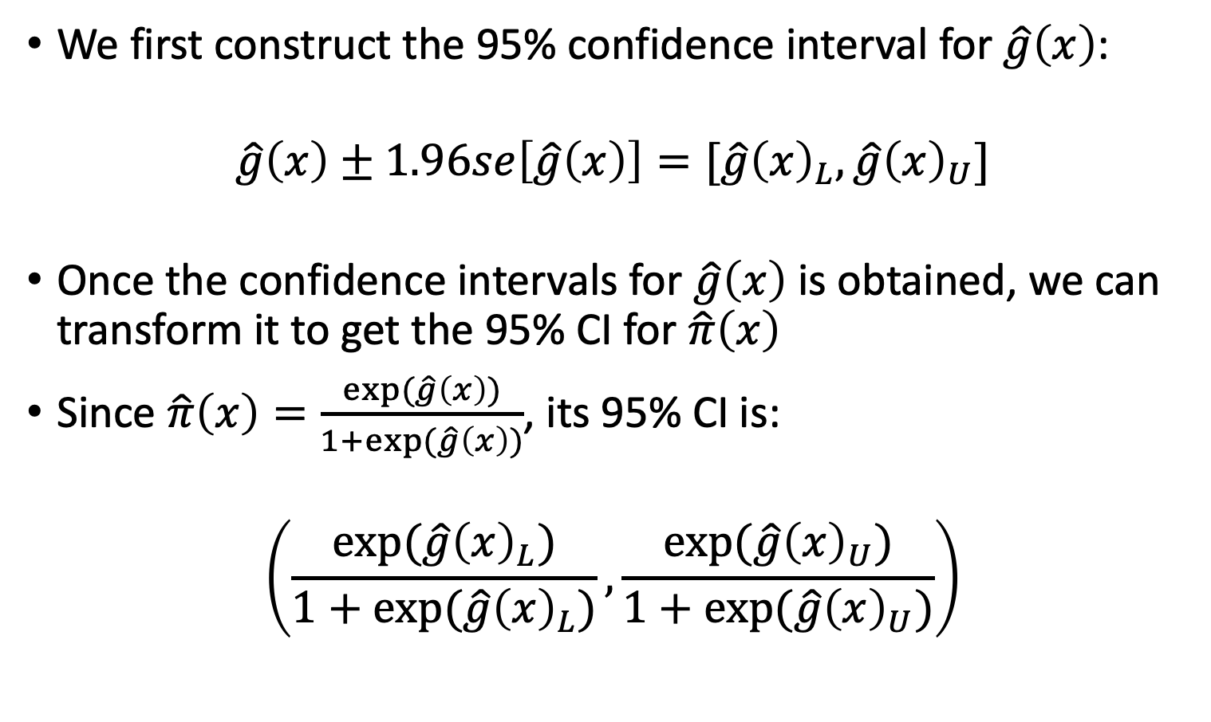
Confidence Interval for Predicted Probability (I)
We first construct the 95% confidence interval for $\hat{g}\left(x\right)$:
$$\hat{g}\left(x\right)±1.96se\left[\hat{g}\left(x\right)\right]=[\hat{g}{\left(x\right)}_{L},\hat{g}{\left(x\right)}_{U}]$$
Once the confidence intervals for $\hat{g}\left(x\right)$ is obtained, we can transform it to get the 95% CI for $\hat{π}\left(x\right)$
Since $\hat{π}\left(x\right)=\frac{exp⁡(\hat{g}\left(x\right))}{1+exp⁡(\hat{g}\left(x\right))}$, its 95% CI is:
$$\left(\frac{exp⁡(\hat{g}{\left(x\right)}_{L})}{1+exp⁡(\hat{g}{\left(x\right)}_{L})},\frac{exp⁡(\hat{g}{\left(x\right)}_{U})}{1+exp⁡(\hat{g}{\left(x\right)}_{U})}\right)$$

Slide 53
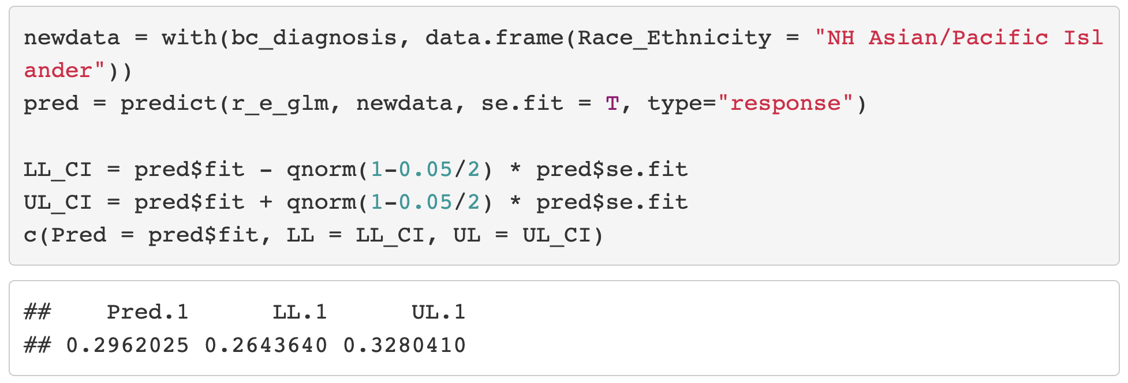
Confidence Interval for the Predicted Probability (IV)

Slide 54
Class 6 Learning Objectives
Determine coefficient estimates using maximum likelihood estimation (MLE)
Test the significance of estimated coefficients and create confidence interval for each using three tests
Predict the probability of “success” for an individual with specific covariate values
Construct and fit a multiple logistic regression model (if time)
**For all learning objectives: start with mathematical derivation, then do in R!

Slide 55
Introduction to Multiple Logistic Regression
In multiple logistic regression model, we have > 1 independent variable
Sometimes referred to as the “multivariable regression”.
The independent variable can be any type:
Continuous
Categorical (ordinal or nominal)
We will follow similar procedures as we did for simple logistic regression
But we need to change our interpretation of estimates

Slide 56
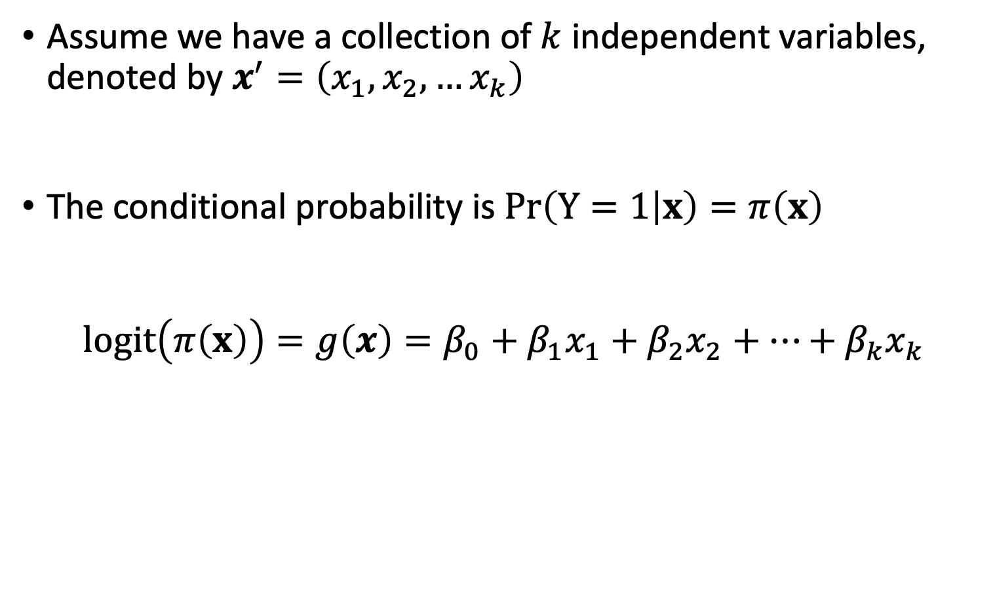
Multiple Logistic Regression Model (I)
Assume we have a collection of $k$ independent variables, denoted by $x^{′}=\left(x_{1},x_{2},…x_{k}\right)$
The conditional probability is $Pr\left(Y=1 | x\right)=π\left(x\right)$
$$logit\left(π\left(x\right)\right)=g\left(x\right)=β_{0}+β_{1}x_{1}+β_{2}x_{2}+…+β_{k}x_{k}$$

Slide 57
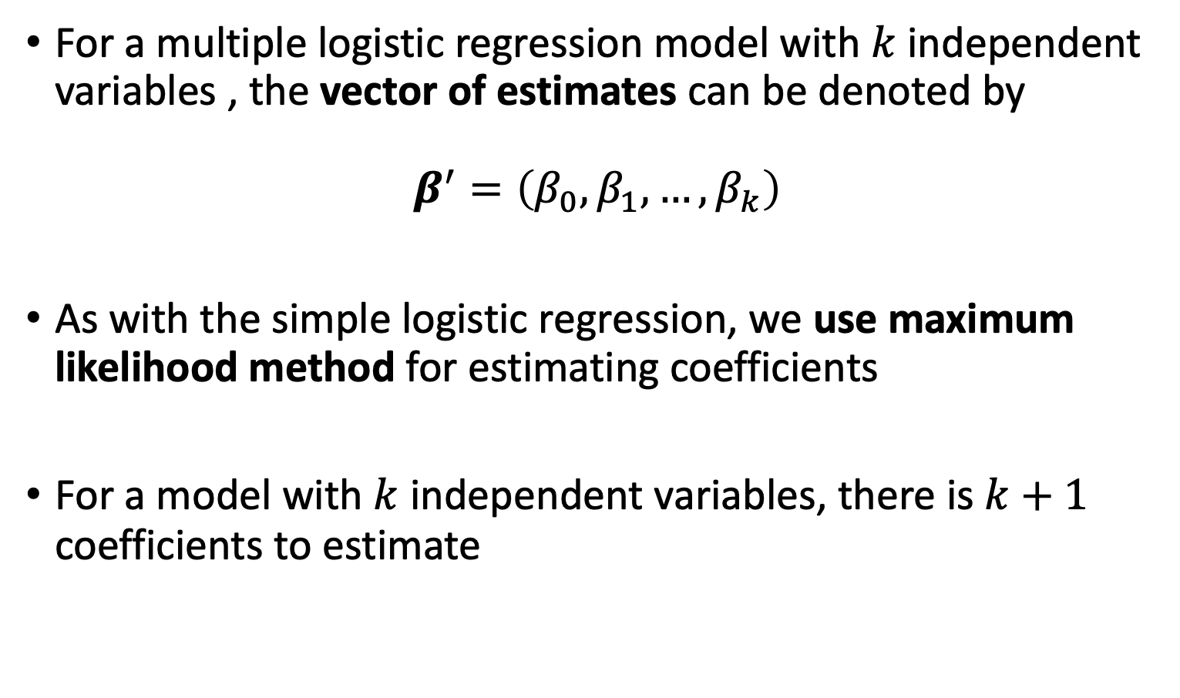
Fitting the Multiple Logistic Regression Model (I)
For a multiple logistic regression model with $k$ independent variables , the vector of estimates can be denoted by
$β^{′}=\left(β_{0},β_{1},…, β_{k}\right)$
As with the simple logistic regression, we use maximum likelihood method for estimating coefficients
For a model with $k$ independent variables, there is $k+1$ coefficients to estimate

Slide 58
Breast Cancer Example
For breast cancer diagnosis example, recall:
Outcome: early or late stage breast cancer diagnosis
Primary Covariate: Race/ethnicity
While non-Hispanic white individuals are more likely to be diagnosed with breast cancer, non-Hispanic black individuals have the highest death rate
Racism affecting health care quality
Additional covariate: Age
Also a risk factor for cancer diagnosis
We want to fit a multiple logistic regression model with both risk factors included as dependent variables
https://www.ncbi.nlm.nih.gov/pmc/articles/PMC6941147/
https://www.nature.com/articles/s41572-021-00258-1

Slide 59
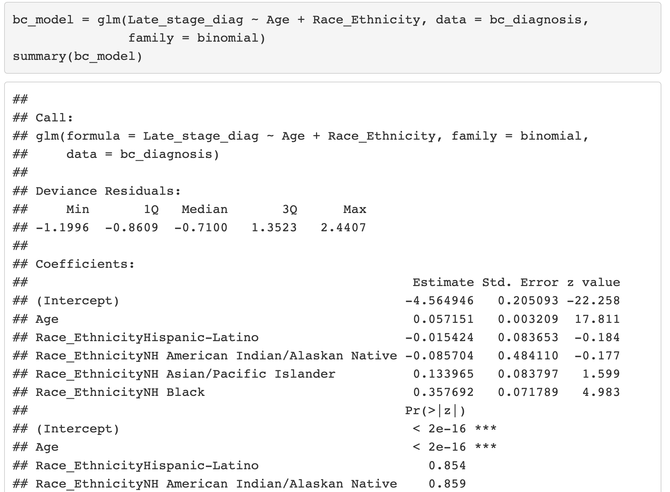
Fitting Multiple Logistic Regression Model

Slide 60
Class 6 Learning Objectives
Determine coefficient estimates using maximum likelihood estimation (MLE)
Test the significance of estimated coefficients and create confidence interval for each using three tests
Predict the probability of “success” for an individual with specific covariate values
Construct and fit a multiple logistic regression model (if time)
**For all learning objectives: start with mathematical derivation, then do in R!

Slide 61

Wrap-up
4-minute exit ticket
Next class
Multiple logistic regression!
Review some of the concepts we applied to simple logistic regression
Dive deeper into interpretation of coefficients
https://forms.office.com/r/4rFGQN36TB

